Slide 1
HELLO EVERYONE!
HOPE YOU ALL ARE DOING GREAT.

Slide 2
ENG-110M
Presentation Group 5
Group Members:
Abeera Naeem
Ameer Hamza
Mohsin Imran
Abdullah Asad
Sufyan Ahmad

Slide 3
TOPIC
T
IS FOR
FOR
THE DAY

Slide 4
ACTIVE VOICE
PRESENTED BY:
Group 5
AND
PASSIVE VOICE

Slide 5
WHAT ARE ACTIVE VOICE AND PASSIVE VOICE?
ACTIVE VOICE
PASSIVE VOICE
ACTIVE VOICE IS THE TYPE OF VOICE IN WHICH THE DOER OF THE ACTION (SUBJECT) IS MADE PROMINENT .
PASSIVE VOICE IS THE TYPE OF VOICE IN WHICH THE ACTED UPON (OBJECT) IS MADE PROMINENT .
EXAMPLE:
Sara sings a song
EXAMPLE:
A song is sung by Sara

Slide 6
How to convert Active into Passive .
First of all , identify the type of tense used in the sentence.
Use the specific rule for that type of tense (predefined) .
Replace the Subject with the object (swap).
Use helping verb accordingly .
Use of “ by “ when referring the object .\
Always use the third form of verb when converting active into passive .
Use the possessive form of pronoun if mentioned in the object.

Slide 7
TENSE RELATED RULES IN A/P VOICE
SIMPLE TENSES
CONTINUOUS TENSES
PERFECT TENSES
When converting a continuous active voice the use of “Being” along with helping verbs is,am,are,was,were is used.
Example :
She is eating pizza.(a/v)
Pizza was being eaten by her.
When converting a continuous active voice the use of “been” along with helping verbs has, have and had is used.
Example :
She has eaten pizza.(a/v)
Pizza has been eaten by her.
When converting a simple active, use of helping verbs is,am,are are supported.
When past tense was and were are used .
And when future tense ,the use of will be is done .
Example :
She ate pizza last night .(a/v)
Pizza was eaten by her last night.

Slide 8
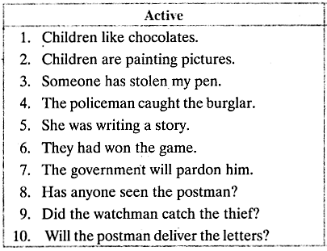
LETS DO A QUICK EXERCISE:
Try to convert them using the basic steps :

Slide 9
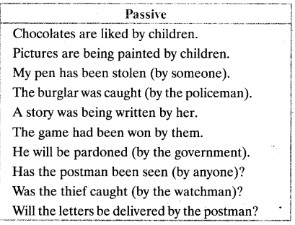
LETS DO A QUICK EXERCISE:
Now lets look at the answers:

Slide 10

TO BE NOTED !
The passive voice for Perfect Continuous Tenses does not exist .

Slide 11
SOME MORE RULES
Forming Passive With Modals..
Passive of imperative
sentences :
Negative/Interrogative sentences :
Let + object + be + past participle.
E.g.:
Active: Carry it home.
Passive: Let it be carried home.
Active: Do it at once.
Passive: Let it be done at once.
Active: Open the door.
Passive: Let the door be opened.
Subject + Do/does+ not + V1 + Object + is/am/are+ not + V3+ by Subject
Does+ Subject+ V1+Object+? Is/am/are + Object+ V3+ by subject +?.
Object + may, must, can, could, ought to, should + be + verb
E.g.:
You must obey the traffic rules.(a/v)
The traffic rules must be obeyed.(p/v)
Recap 2

Slide 12
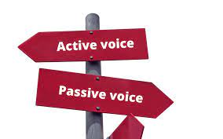
THANK YOU!
Hope you got it well.
IF YOU HAVE ANY QUESTIONS REGARDING THE TOPIC,
YOU MAY ASK .

Slide 13
RESOURCES
Use these free resources to learn much more about the topic .
https://learnenglish.britishcouncil.org/english-grammar-reference/active-and-passive-voice
https://www.grammarly.com/blog/active-vs-passive-voice
https://scoop.eduncle.com/active-and-passive-voice-rules

